Slide 1

The Battle of Neighborhoods
THE MOST SUITABLE NEIGHBORHOODS IN TORONTO FOR NEW IMMIGRANTS

Slide 2
objective of analysis
Ranked as one of the top countries to live in according to its unprecedented quality of life, public education system as well as medical facilities, Canada has been seeing a massive rise in the number of new immigrants over the past decades. When it comes to the place for newcomers to settle down, Toronto is always among the first destinations to consider.
The objective is to provide some guidance to those new immigrants who will be looking for a suitable neighborhood in Toronto for them to settle down, based on a comparative analysis on various features and amenities across different neighborhoods. It is understood that immigrants will pick their own neighborhood based on different criteria depending on their own characteristics and preferences. In this project, the analysis is aiming for those families with a particular focus on the income level and education background of the residents living in the neighborhood. A high income and education level is normally a reflection of the safety of the community and relatively good manners of the residents. Some other common amenities such as restaurants and grocery stores nearby are also taken into account in this analysis. This project can always be modified and customized for those families who consider other attributes as driving factors to decide on which neighborhood to settle down.

Slide 3
Data
Neighborhood location information of Toronto
Location information of Toronto neighborhoods is available from the previous assignment in this course, which includes the postal code, longitude and latitude information for each neighborhood in the city of Toronto.
Neighborhood profile of Toronto
The neighborhood profile is obtained from the Census of Population. The profile collects data about age and sex, language, immigration and internal migration, ethnocultural diversity, housing, education, income, and labour, among which population, education, and income information is of interest in this analysis. Due to the fact that the Census is held across Canada every 5 years, data to be used is from the most recent Census in year 2016.
Data source publicly available : https://www.toronto.ca/city-government/data-research-maps/open-data/open-data-catalogue/#8c732154-5012-9afe-d0cd-ba3ffc813d5a
Venue information of interest
Venue information of interest (i.e. restaurants and grocery stores) is obtained using the Foursquare API based on the longitude and latitude coordinates of the neighborhood.

Slide 4
METHODOLOGY
Step 1 : Identify the neighborhoods of Toronto in which residents have high income and education background to construct the pool of neighborhoods of interest for the analysis
Step 2 : Locate those neighborhoods selected from previous step
Step 3 : Connect to Foursquare and retrieve venue data of interest within each neighborhood
Step 4 : Apply machine learning technique (K-Means Clustering) to analyze the data
Step 5 : Make decisions on the most suitable neighborhood based on statistical indicators

Slide 5
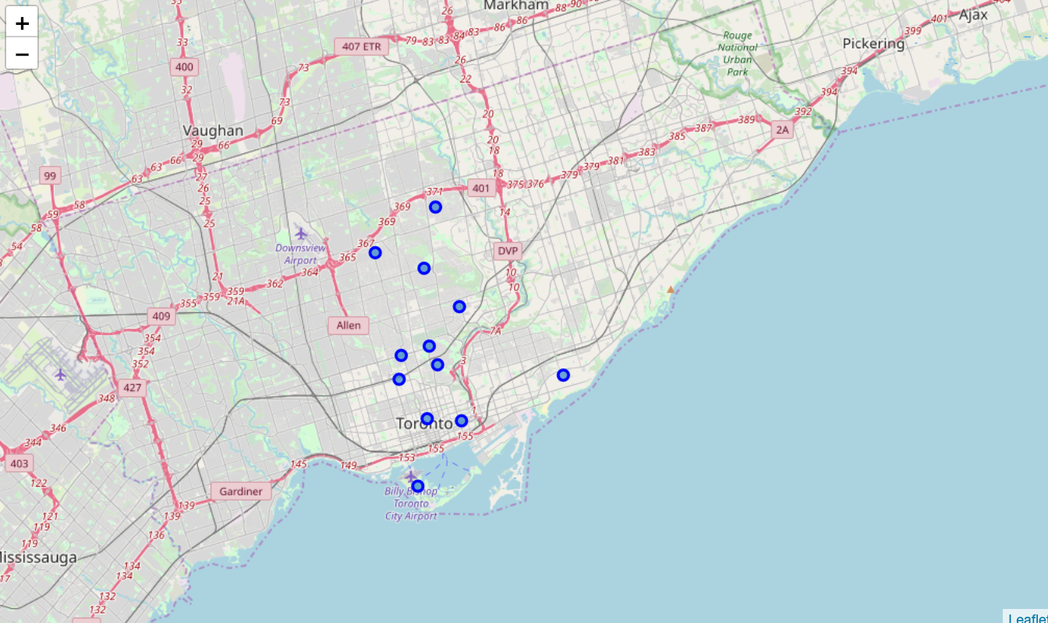
Results
12 neighborsoods are identified from Census that have a high income and education level within the neighborhood.

Slide 6

Results (cont’d)
Venue data for each of the 12 neighborhoods are obtained by connecting to API foursquare. Only the following venues of interest, which is related to places for food, are extracted from a total of 174 venue categories.
All kinds of restaurants (Asian, French, American, etc)
All kinds of joints (BBQ, burger, etc)
Grocery and convenience stores
Applying K-means clustering (K=5), the neighborhoods are grouped into 5 clusters, and then the sum score of all venues are computed.
Cluster | Venue Total Sum Score
5 | 54.0
3 | 53.0
1 | 50.3
4 | 38.5
2 | 7.2

Slide 7
Results (cont’d)
Clusters 5, 3, and 1 have the highest venue scores (54, 53, and 50 respectively). Cluster 2 has the lowest score (7.2). The neighborhoods that belong to Clusters 5, 3, and 1 are identified.
Neighborhood | Cluster
York Mills | 1
Rosedale | 5
Moore Park | 2
Forest Hill South | 1
Lawrence Park South | 2
Waterfront Communities | 4
The Islands | 1
Annex | 2
Leaside | 4
Bay Street Corridor | 2
Bedford Park | 3
The Beaches | 2

Slide 8
CONCLUSIONS
The following neighborhoods are recommended to those new immigrants who are seeking for a community with a relatively high income and education level, and a good accessibility to places for food within the neighborhood:
Rosedale
Bedford Park
York Mills
Forest Hill South
The Islands
The analysis can be customized for other immigrants that take into account other criteria and driving factors.
Limitations: due to complexity, the analysis presented did not consider housing availability and prices within the neighborhood. The future study may include these factors and other considerations to achieve a more comprehensive scope.

